Slide 1
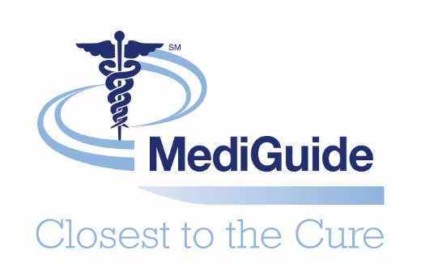

Slide 2
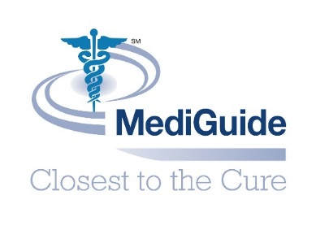
Innovation in health care services

Slide 3
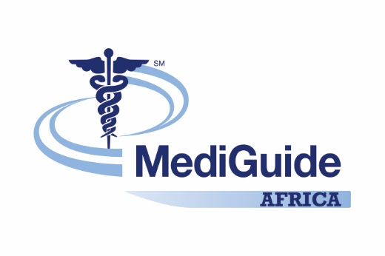
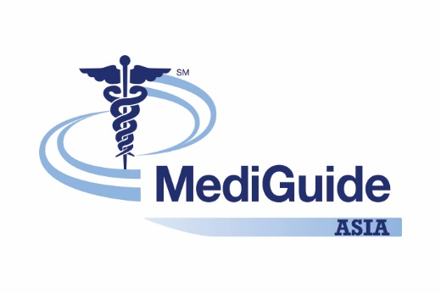
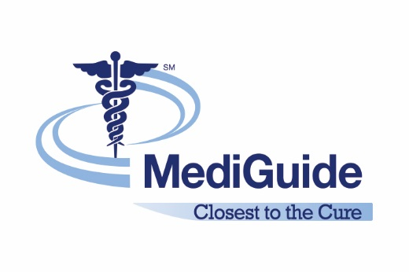
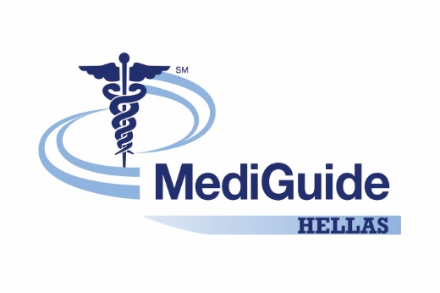
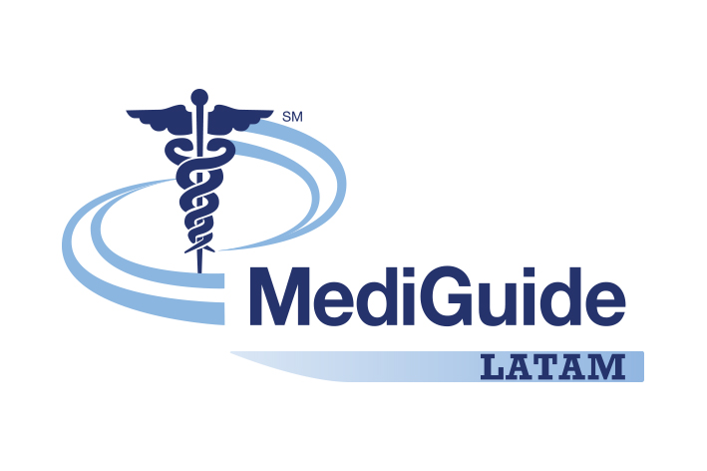
MediGuide Group

Slide 4
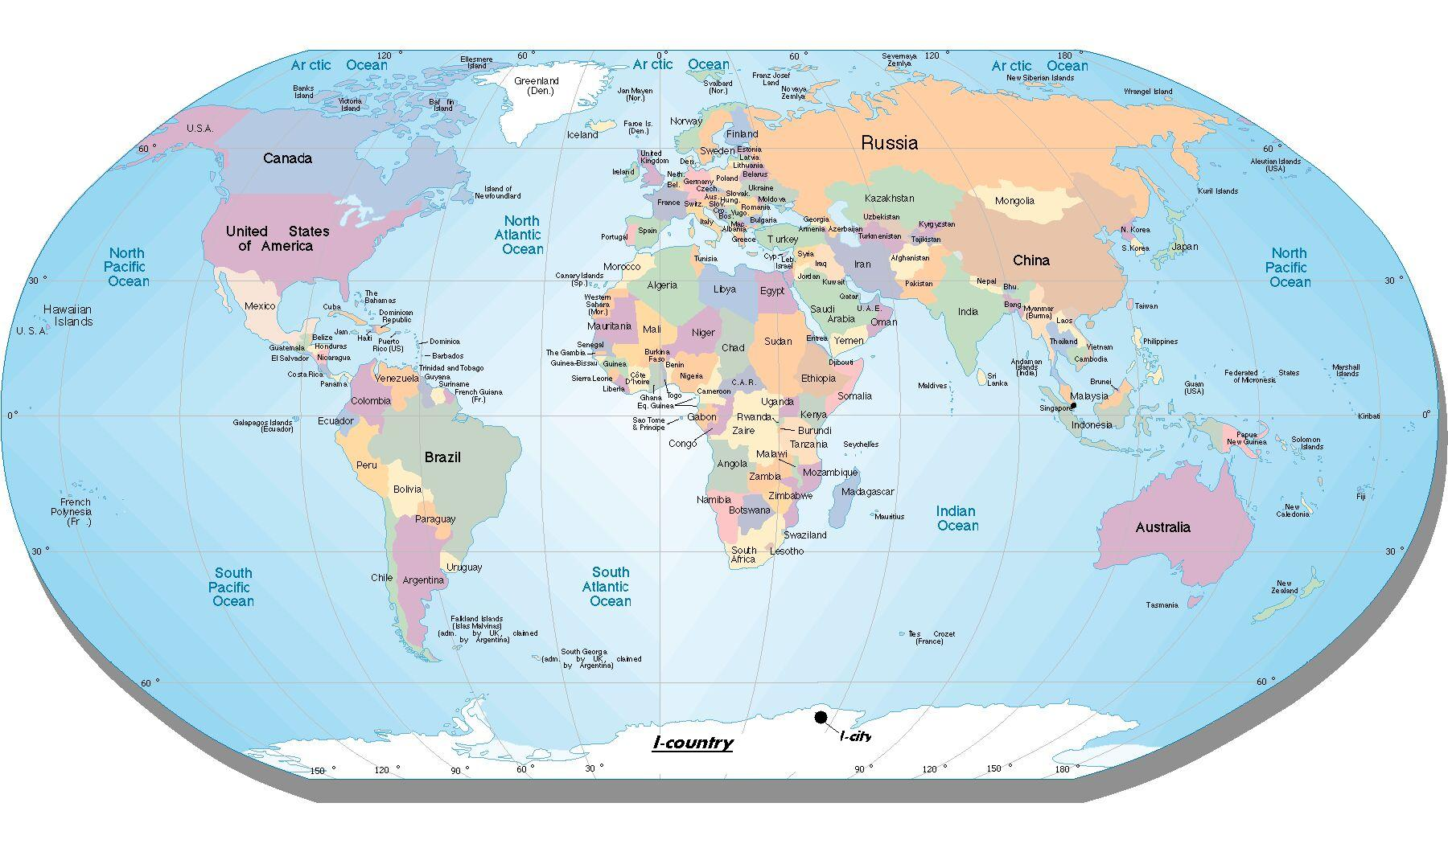
Geographic Footprint
MediGuide is operating 47 countries on 4 continents.
MediGuide is servicing customers in 152 countries.
Notes:
Why is that important to you? The more we learn from our customers around the globe, the more we will be able to serve, understand and help the customers, our members in your markets.

Slide 5
MediGuide
Medical Second Opinion
LifeLink
My Specialist
MD
Navigator

Slide 6
MediGuide Capabilities
Medical Second Opinions
Navigator
MSMD

Slide 7
MediGuide: Closest to the Cure
Member benefits from MediGuide services include:
Early and highly ACCURATE diagnosis Optimized diagnostic approach Cutting-edge treatment protocols
MediGuide suggests three World Leading Medical Centers to the Member, not on their fee structure or any network participations, but rather, based on careful analysis of the Member’s medical history and condition and identification of medical centers that most fit those needs.

Slide 8
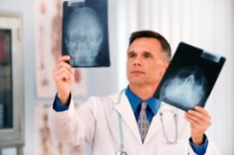
Qualifying Medical Conditions
MediGuide is able to review ANY medical diagnosis with a MSO with the exception of the following circumstances:
No diagnosis
No evaluation by a treating physician for >1 years
Condition is acute or life-threatening (requires immediate medical intervention)
An in person evaluation is required (e.g. mental illness)

Slide 9
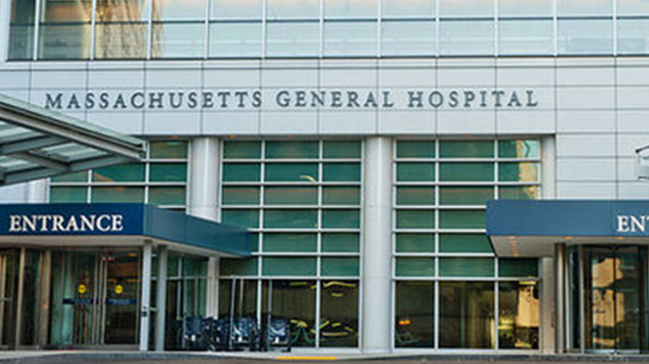
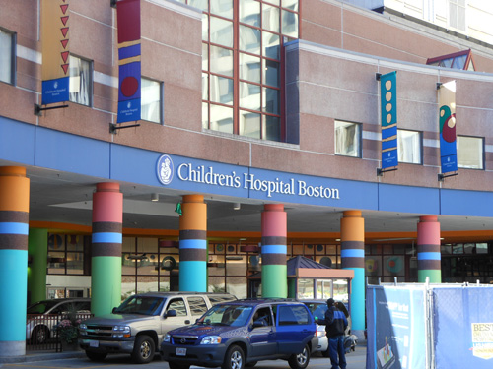
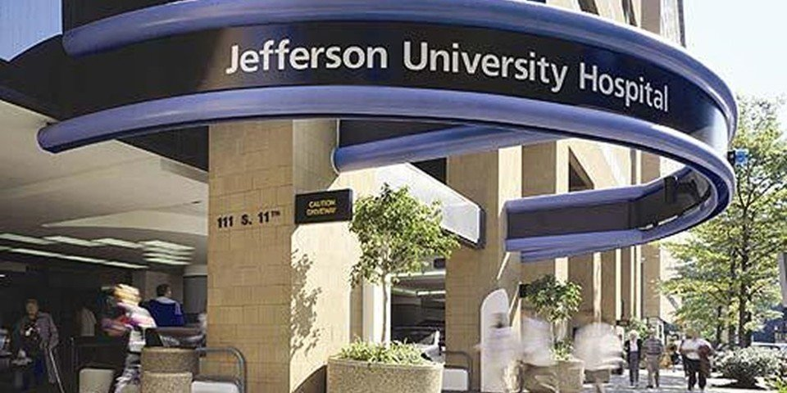
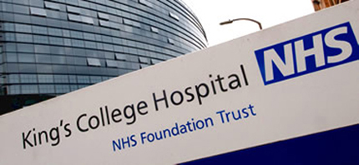
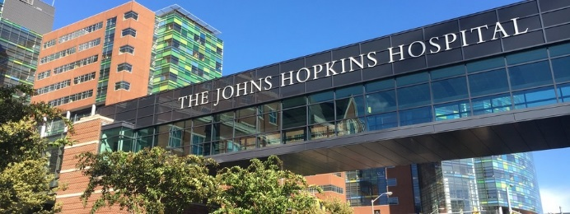
World Leading Medical Centers

Slide 10
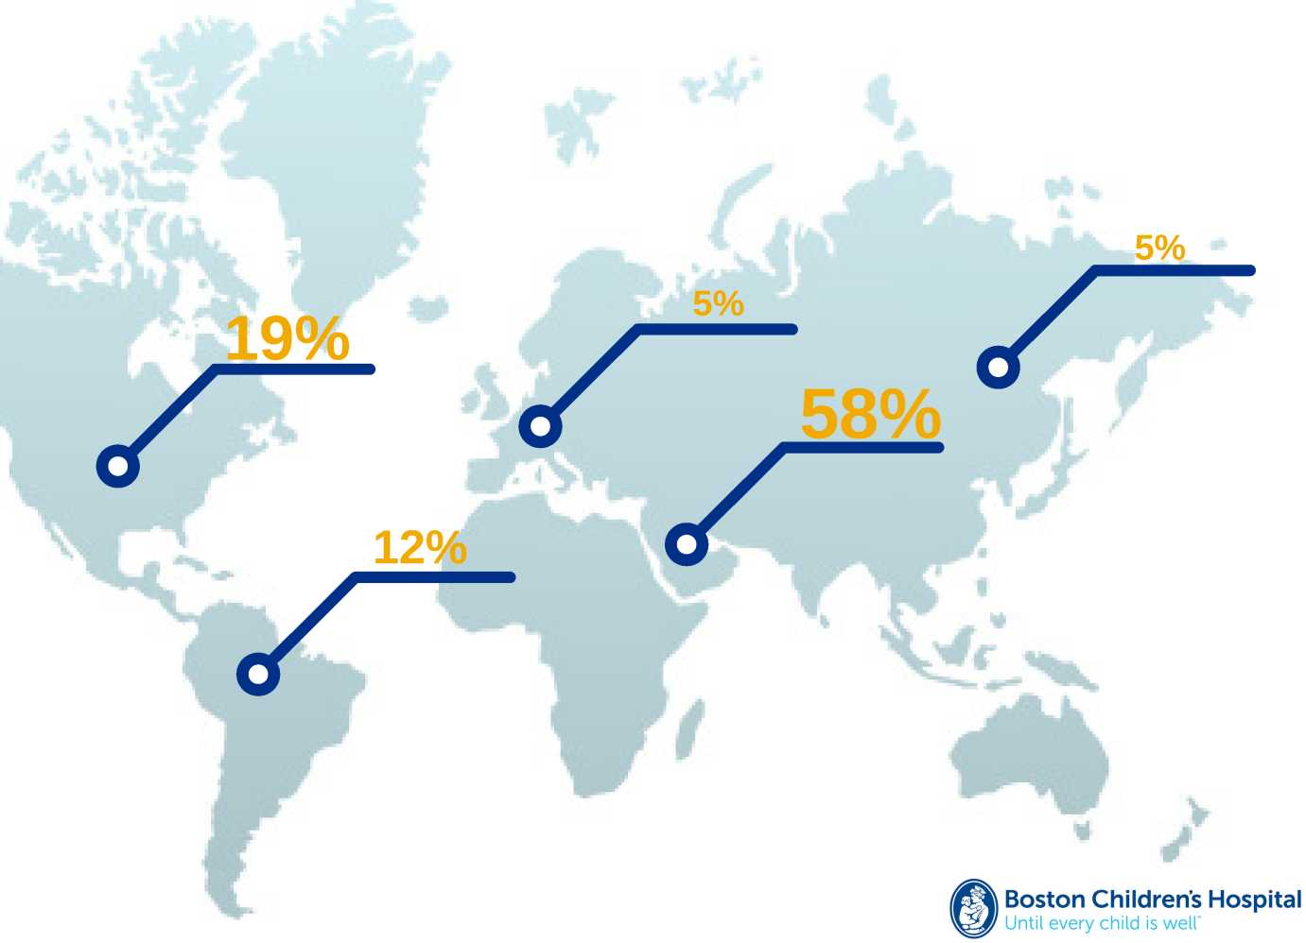
Global Community
2,500 patients from 150 countries

Slide 11
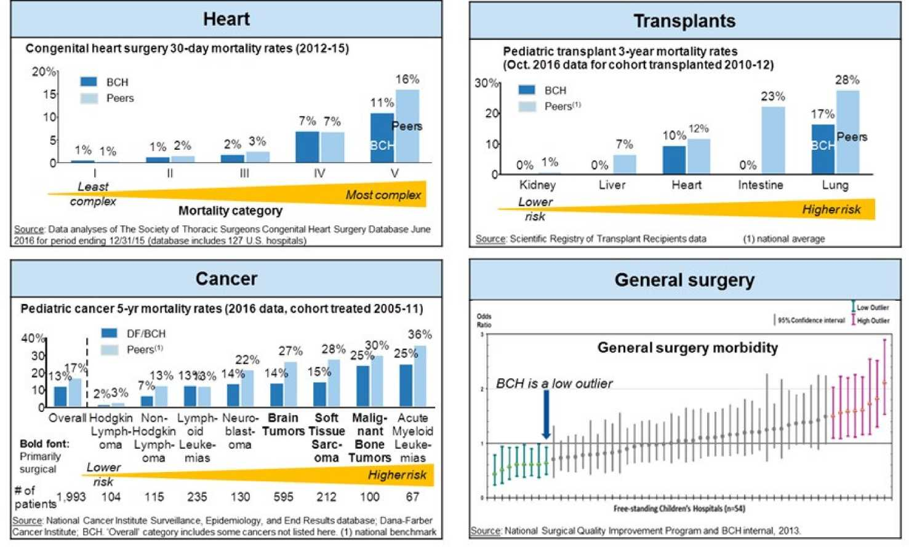
Superior Clinical Outcomes
Boston Childrens Hospital
Until every child is well"

Slide 12
Leading Innovative Research
3,000 annual publications
2
8
14
28
NOBEL PRIZE WINNERS
NATIONAL ACADEMY OF SCIENCES
INSTITUTE OF MEDICINE
AMERICAN SOCIETY FOR CLINICAL INVESTIGATION
472 Private Investigators
1,400 Research Scientists
Boston Childrens Hospital
Until every child is well"

Slide 13
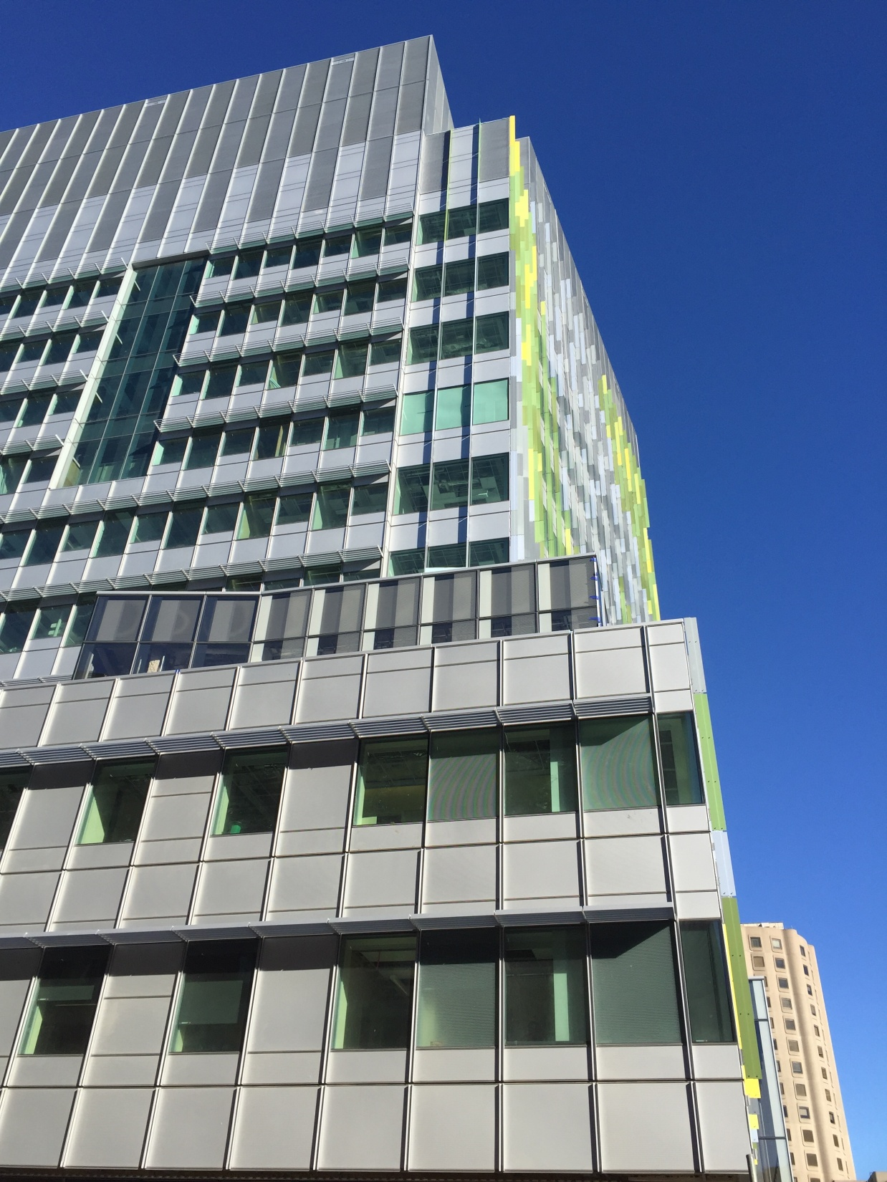
Brigham Building for the Future
12-story Translational Research Center with 600,000 square feet of state-of-the-art, multidisciplinary research and ambulatory care, including:
Wet and Dry Research – Eight floors with more than 670 lab benches, 550 write-up stations, 290 offices, 440 workstations, and vivarium for Neurology, Neurosurgery, Neuropathology, Nanotechnology, MSK, Rheumatology, Allergy, Immunology, Regenerative Medicine;
Ambulatory Clinics for Neurosciences and Orthopaedics – Two floors with total of 77 exam rooms, numerous consult rooms, bone and joint imaging, clinical research enrollment rooms and workstations;
Clinical Support – Phlebotomy, Pharmacy, Infusion Suite, and Neurodiagnostic Testing;
Advanced Imaging – Two 3T MRIs, one 1.5T MRI and a CT for clinical use; a 3T fMRI and a new generation 7T MRI for research;
Clinical Research Hub – Enrollment and consent rooms, touchdown stations for clinical researchers.

Slide 14
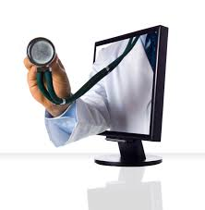
What can I expect?
MediGuide MSO & ROI Recent Case Study .pdf

Slide 15
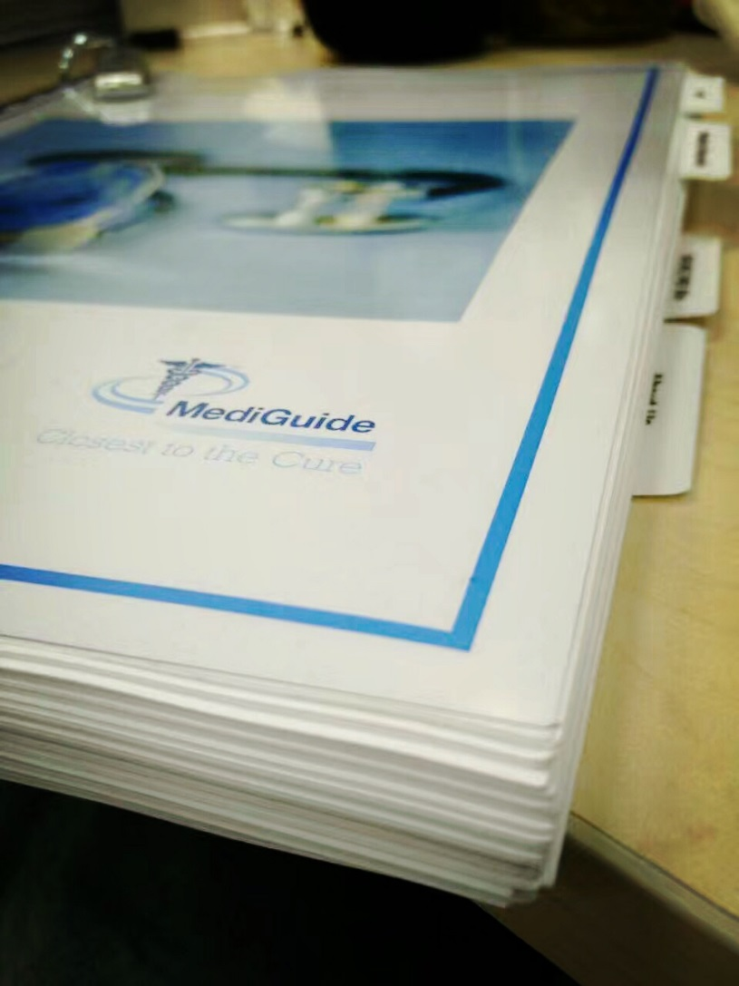
What can I expect?
My MediGuide Casebook consists of the following items;
The member’s Medical Second Opinion (original and translated version if necessary)
The member’s Medical Records
Medical center and expert physician biographies
Related journal articles referenced by the expert physician(s), and
Contact information for MediGuide.
The file will also include a USB flash drive containing all of the member’s medical records collected by MediGuide during the MSO process.
The review packet will be sent to our members within one week of the conclusion of their case.

Slide 16
2018 Key MSO Metrics
Net promoter score | 4.84/5 | 92,7% responses
Average case TAT | 10.23 | business days
Change in diagnosis | 5% | 2018
Change in treatment | 84% | 2018
Cases cancelled | 25% | 2018

Slide 17
Top 8 MSO Conditions 2018
Notes:
oncology 70 orthopaedic 25 cardiology/vascular 15 neurology 13 neurosurgery 10 ob/gyn 8 ENT 6 GI 6 derm 5 nephrology/urology 4 pulmonology 3 rheumatology 3 endocrinology 2 general surgery 2 hematology 2 pain management 2 allergy 1 behavioral health 1 infectious disease 1

Slide 18
Top WLMC Choices 2018
Notes:
Massachusetts General Hospital- Boston, MA 49 Johns Hopkins University (International)- Baltimore, MD 46 Dana-Farber Cancer Institute - Boston, MA 29 Rothman Institute (PIM) 13 Boston Children's Hospital - Boston, MA 9 Massachusetts General Hospital for Children 9 Cedars-Sinai Medical Center - Los Angeles, CA 8 Fox Chase Cancer Center (PIM) 7 Brigham & Women's Hospital 6 Hospital of the University of Pennsylvania - Philadelphia, PA 4 Great Ormond Street Hospital for Children 3 MSMD Telemed 2 Thomas Jefferson University Hospital (PIM) 2 Massachusetts Eye and Ear 1 Sidney Kimmel Cancer Center (PIM) 1 University of Pittsburgh Medical Center - Pittsburgh, PA 1

Slide 19
What can I expect: Cost Savings?
Cost savings for insurance companies can occur for :
Health Insurance (Reimbursement type)
Health Insurance (Lump Sum based)
Disability Insurance (sickness and accident)
Term Life

Slide 20
MediGuide Capabilities
Medical Second Opinions
Navigator
MSMD

Slide 21
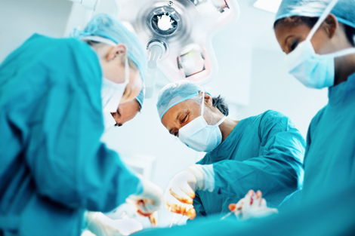
MediGuide’s Navigator
Medical Second Opinion
Admittance in a World Leading Medical Center or alternative Medical Center
Travel Services
Airport pick up service
Translation services
Repatriation of mortal remains
Re-pricing of hospital bills

Slide 22
Navigator
MEDIGUIDE’s network of internationally recognized Providers will provide regional specific medical assistance.
Once the MEDIGUIDE Provider is identified to the Member, the MEDIGUIDE Provider will assist the Member with :
Advice on recommended facilities to the Member based on the Member’s medical second opinion and arrange admission;
Provide the Member with a cost estimate for the treatment package.
Settlement of claims from medical providers in and out of network.
Case Management.
Pharmacy review of prescribed drugs if relevant.

Slide 23
Travel Related Services
Travel arrangements
Hotel booking
Airport pick up
Repatriation of mortal remains
Travel expenses will be born by the member.

Slide 24
Translation Services
Available for more than 200 languages and dialects;
Any pair of languages;
24/7;
Toll free access number in country of destination.

Slide 25
Re-Pricing and Cost Containment
MediGuide’s Regional Provider will work on a ‘no cure, no pay’ basis;
In total the Member will pay 25% of the savings obtained.

Slide 26
Average Cost of treatments USA (before cost containment)
Average Charges for Treatments
(Before cost containment)
2016 Average Costs Nationwide | USD
Aorta Valve Replacement or other Cardiothoracic Procedures | 159,641
Craniotomy for Multiple Significant trauma | 190,530
Coronary Artery Bypass surgery | 188,758
Cancer
Mastectomy | 44,724
Prostatectomy | 93,903
Pancreas cancer | 178,616
Ovarian cancer | 139,929
Kidney Failure | 74,785
Heart Transplant | 976,014
Kidney Transplant | 207,160
Lymphoma and Leukemia with major O.R. procedures | 195,885
Acute Leukemia without O.R. procedures, age 0-17 | 173,131
Bone Marrow Transplant | 205,510
Liver Transplant | 498,763
Chemotherapy with acute Leukemia as secondary diagnosis | 81,776
Lung Transplant | 495,615

Slide 27
Re-pricing impact

Slide 28
Costing example
Example :Pancreatic cancer
Gross Hospital Bill: $178,616
Re-Pricing discount (savings): 55% or $98,238.80
Cost for Member
At dismissal: $24,559.70 (25% of savings)
Net Hospital Bill: $178,616 – $98,238.80 = $80,377.20
Total cost to member: $104,936.90
Net savings $73,679.10

Slide 29
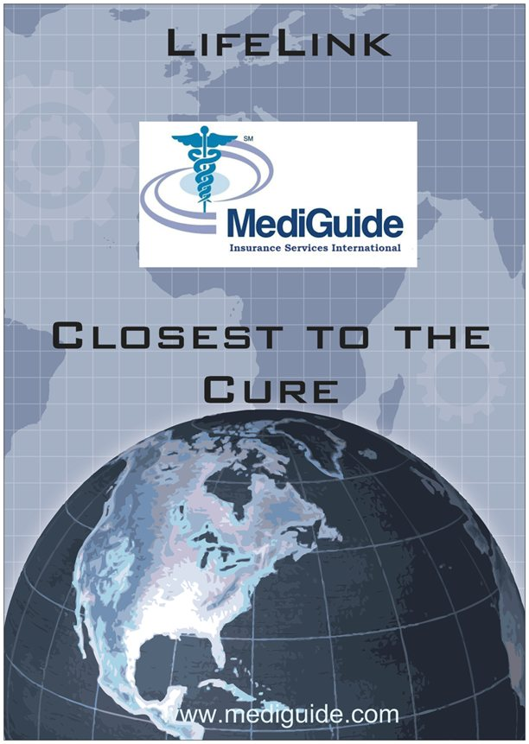
MediGuide Capabilities
Medical Second Opinions
Navigator
MSMD

Slide 30
http://demo.msmdcare.com/msmd-patient/consults.htm

Slide 31
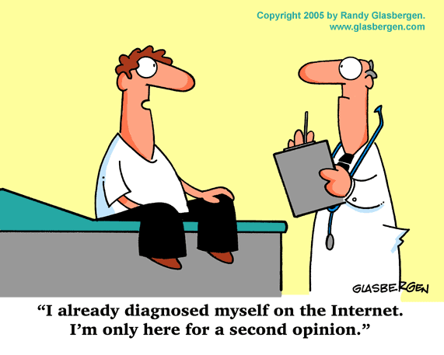

Slide 32
